Slide 1

Understanding The Color Wheel
The Color Wheel & Color Harmonies

Slide 2



The Color Wheel
Primary
Secondary
Orange, Purple, Green
(Primary + Primary)
Tertiary
Ex. Yellow + Orange = Butterscotch-ish Color
(Primary + Secondary)
Proud Partner Of

Slide 3

Color Harmonies
Colors that naturally look good together
They look good, feel balanced, and are pleasing to the eye
Paired based on their location on the color wheel
Easy, proven way to create color schemes

Slide 4

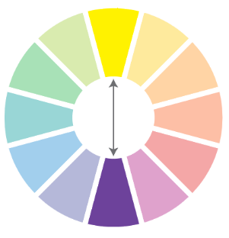



1. Complementary Colors
Example Color Schemes
Neutral
(Champagne)
Neutral
(Champagne and White)
Uses two colors across from each other on the color wheel
Because they are opposites, they make each other stand out

Slide 5


Slide 6





2. Split Complementary Colors
Example Color Schemes
Neutral
(White)
Neutral
(Champagne)
Like the complementary color scheme but it uses three colors instead of two
Offers the benefits of that color pop and contrast, but just a little softer
Spring Bloom
Macaw

Slide 7


Slide 8

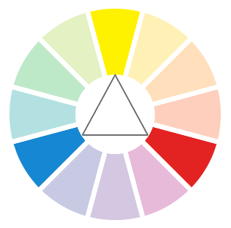



3. Triadic Colors
Example Color Schemes
Neutral
(Champagne)
Three colors evenly spaced around the color wheel
Because of the equal spacing, this scheme creates a balanced look
No single color dominates
Circus
Not Named ☺

Slide 9


Slide 10
Simplified Color Wheel with Color Harmonies
Complementary
Split Complementary
Triadic

Slide 11
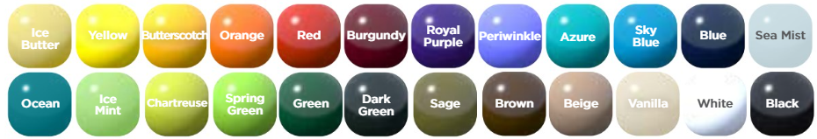

Slide 12

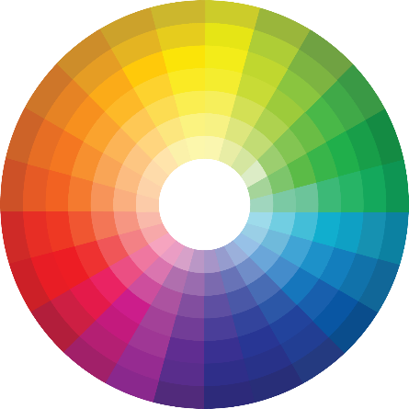
The “Full” Color Wheel

Slide 13

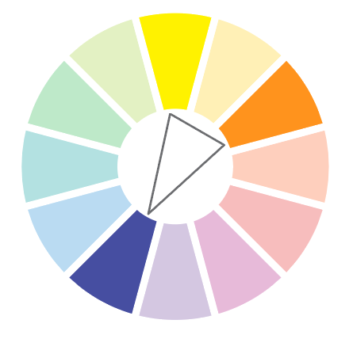
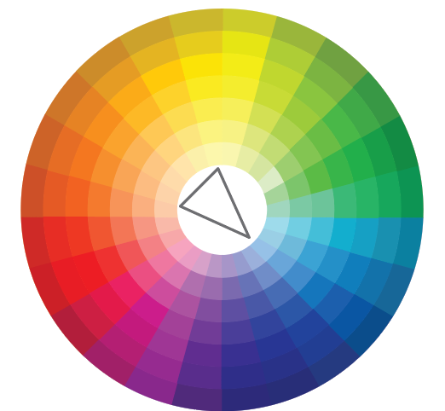
Don’t Be Afraid to Take Liberties
Split Complementary

Slide 14


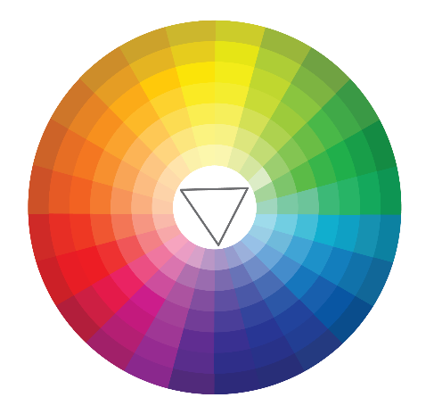
Don’t Be Afraid to Take Liberties
Triadic

Slide 15



What colors are neutrals?

Slide 16



Add a Neutral
(Champagne)
Add a Neutral
(Vanilla)
Lean On Neutrals to Allow Colors to Pop
Notes:
Posts are competing for your attention.

Slide 17

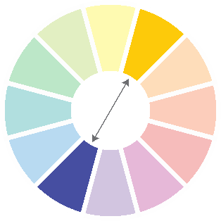




Let’s Apply That Knowledge
Complementary
Split Complementary
Triadic

Slide 18


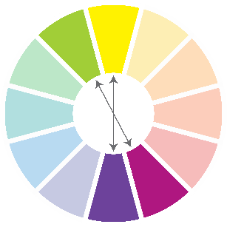
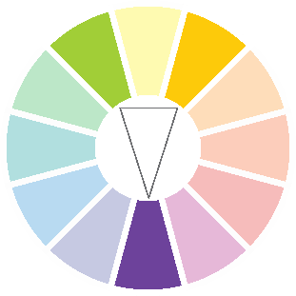


Let’s Apply That Knowledge
X
X
Complementary
Split Complementary
Triadic

